Slide 1
Veterinary Center
Software App System

Slide 2
Introduction:
The system helps to solve some problems such as facilitating dealing with the owner of the pet and knowing the previous condition of the animal and facilitating the task for the doctors by knowing the diseases and previous vaccinations of the animal until it is diagnosed correctly and helps the employees to deal with each other such as booking appointments by the reception staff and coordination between the receptionist ( who booked the appointment) and doctors and nurses.
The functional requirements of the system is to modify, enter or know data information for employees or owners of the pet, knowing the condition of the animal through previous data and sending notifications to the owner about the next vaccination date for the pet.
And the non-functional requirements of the system is security, availability, efficiency, safety, usability, maintainability.
In this project, the feasibility of the system was studied, whether technical feasibility, marketing strategy, operational feasibility or economic feasibility, knowing the benefits of the system and studying the full cost of the system.

Slide 3
Use case templates:
Name: | Update data
Number: | UC 1
Description: | Update the data of the employees or pet`s owners.
Actors: | Employees – pet`s owners – pet – database server - administrator
Pre-Conditions: | The specific data which will updating it is already exist
Scenario: | Administrator search if the data which will updating exist or not If the data exists, the administrator will update it The system automatically will delete the old data and replace it by the new data
Post-Conditions: | System replaces the old data by new data
Exceptions: | If the data which will updating is not exist Administrator can`t reach to database server Database server damaged
Name: | Status of pet
Number: | UC2
Description: | Help the doctor and nurses to know the status of the pet
Actors: | Pet – animal owner– doctor – nurse – Database
Pre-Conditions: | – The status of the pet must be mentioned in database –the doctor and nurse must know about the status of pet
Scenario: | Enter the status of the pet The doctor should know the status of the pet to do his work and treat the animal
Post-Conditions: | The system will be ready to take the status of another pet
Exceptions: | The animal owner enters a false status about the pet The information isn't enough to describe the status of the pet

Slide 4
Name: | Book by The Staff
Number: | UC3
Description: | The employees recording the information of pet`s owners and pet , The animal's owner can call by phone f or reservations
Actors: | Employees – pet`s owners – pet – Mobile phone – Database
Pre-Conditions: | The owner of the animal must call first to make reservations
Scenario: | The employee receives the calls then: 1-answers calls 2-Entering data 3-Keeping records 4-Informing the person responsible in the event of the arrival of pet's owners
Post-Conditions: | The reservation is recorded and the owner of the animal can come at the appointed time
Exceptions: | 1-A malfunction occurs in the phone 2- Unavailability of the appropriate time to book that the owner of the animal wants it. 3-Failure to respond to him when calling (if the center is closed)
Name: | Manage employee
Number: | UC4
Description: | It helps admin to manage employee data (add or remove or edit)
Actors: | Admin – Database – Database server
Pre-Conditions: | Admin must be logged in first
Scenario: | Admin can log in to management then he can do: Add employee Remove employee Edit employee data Edit salary for the employee The modified data will be updated in data base
Post-Conditions: | The system will return to the main admin panel
Exceptions: | Admin can’t log in (username or password error) Try to define salary as zero Add existing employee

Slide 5
Name: | Data entry
Number: | UC 5
Description: | Administrator enter new account of new employee or new pet`s owner or data of new pet to the database
Actors: | Employees – pet`s owners – pet – database server - administrator
Pre-Conditions: | Database is ready to receive new data (account)
Scenario: | Administrator enters to the database Ensure that an employee or pet`s owner or pet has previous data on the database (account) Enter the new data Ensure that the new data is saved in the database
Post-Conditions: | The new data is saved in the database
Exceptions: | The data which will entering is already exist Administrator can`t reach to database server The animal which will entering is wild animal Database server damaged
Name: | Notifications
Number: | UC6
Description: | Notice to the animal's owner about the latest vaccinations
Actors: | Server – Animal’s owner – Database
Pre-Conditions: | The owner of the animal must be registered in database
Scenario: | Appear new vaccinations Server sends announce to animal’s owner
Post-Conditions: | The owner of the animal must go to veterinary center
Exceptions: | The owner of the animal didn’t register in database Any network problems

Slide 6
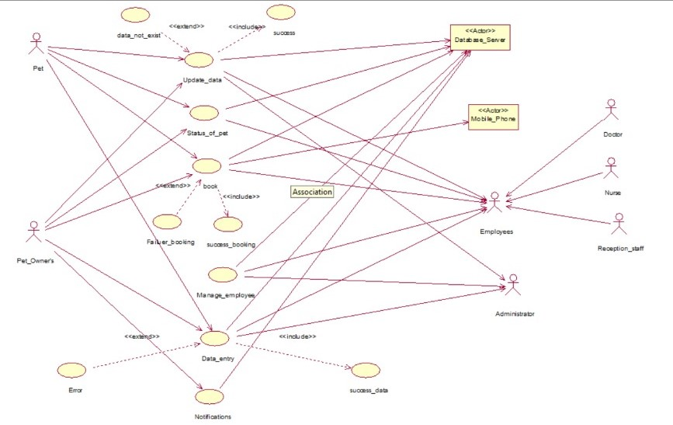
Diagrams of the system:
1) Use case diagram:

Slide 7
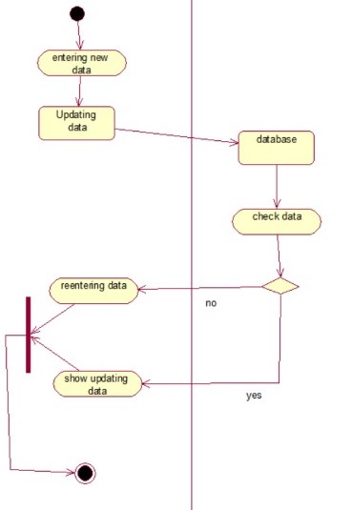
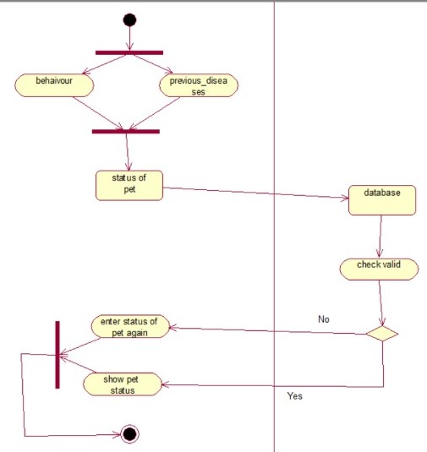
2) Activity diagrams:
Update Data
Status of pet

Slide 8
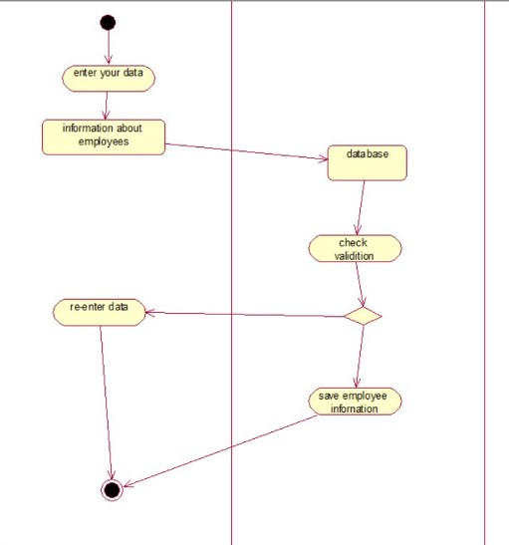
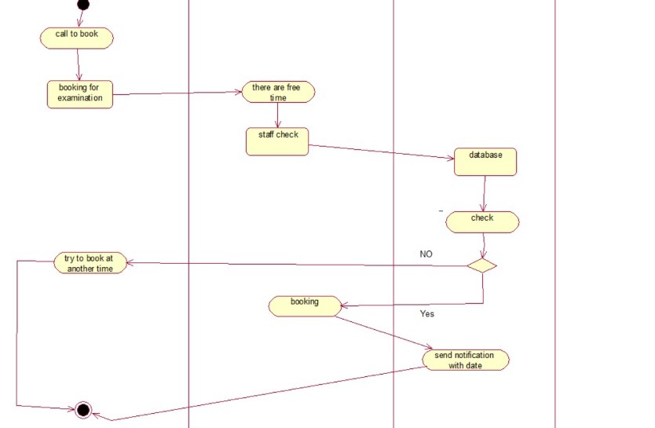
Book by the staff
Manage employees

Slide 9
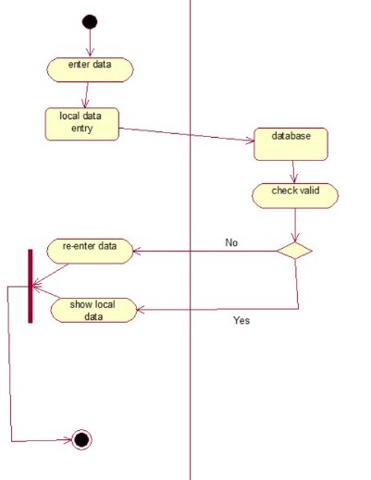
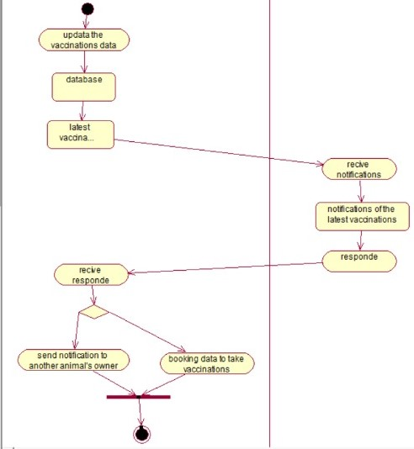
Data entry
Notification about last vaccination

Slide 10
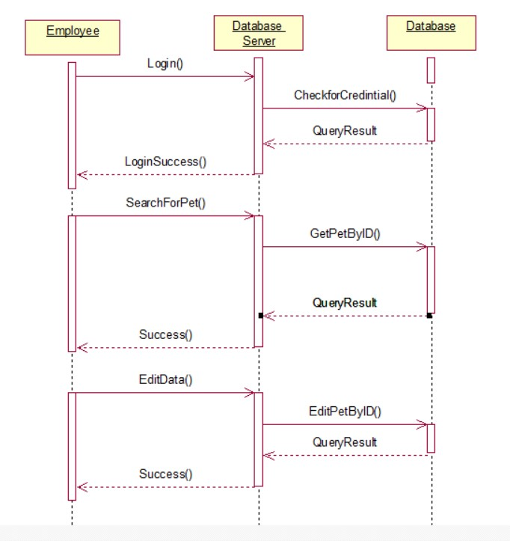
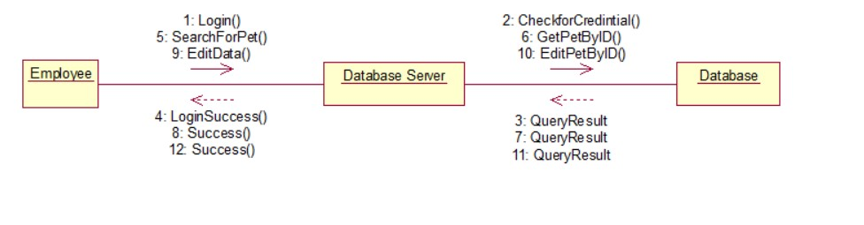
3) Sequence Collaboration:
Sequence diagram for update data
Collaboration diagram for update data

Slide 11
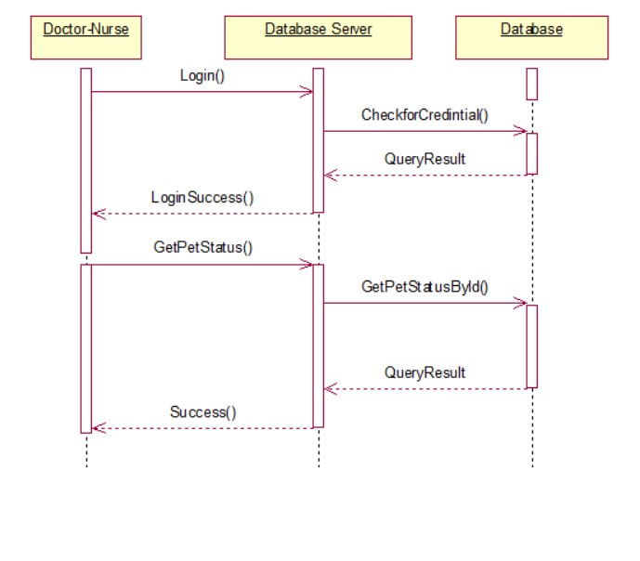
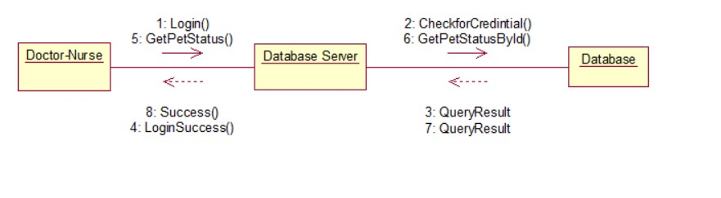
Sequence diagram for status of pet
Collaboration diagram for status of pet

Slide 12
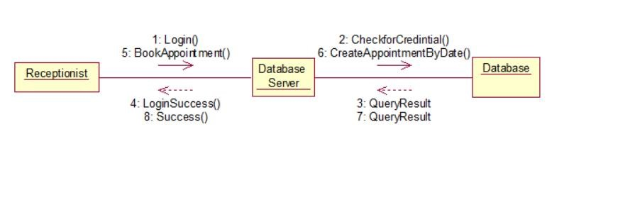
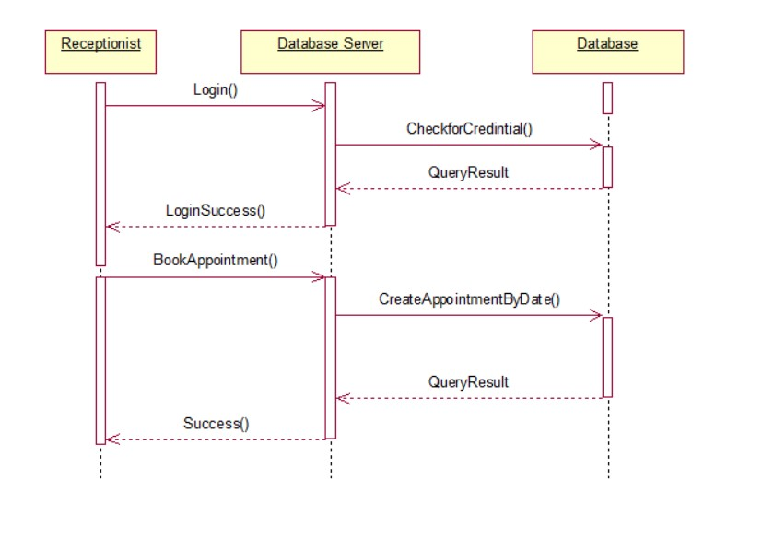
Sequence diagram for book by receptionist
Collaboration diagram for book by receptionist

Slide 13
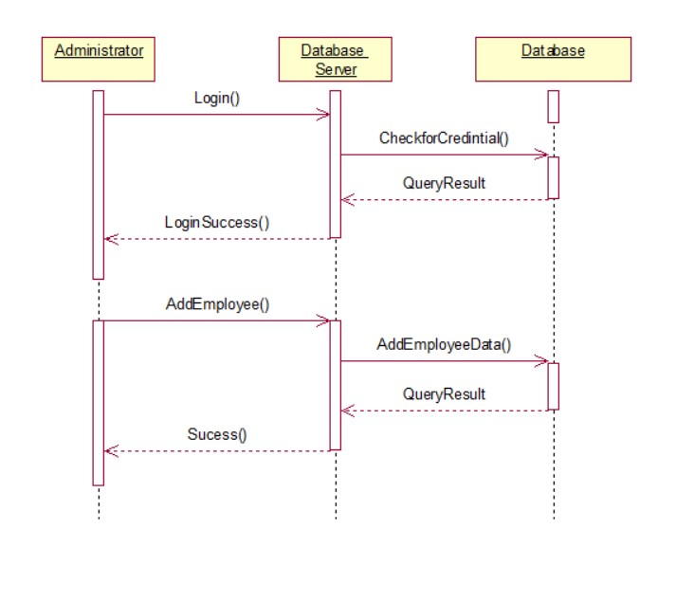
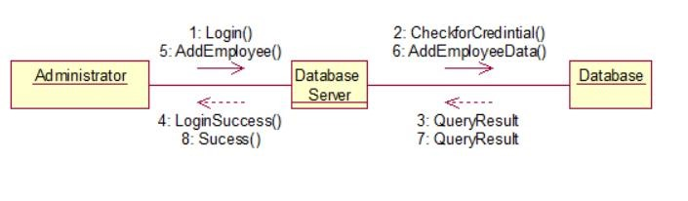
Sequence diagram for mange employee (add employee)
Collaboration diagram for mange employee (add employee)

Slide 14
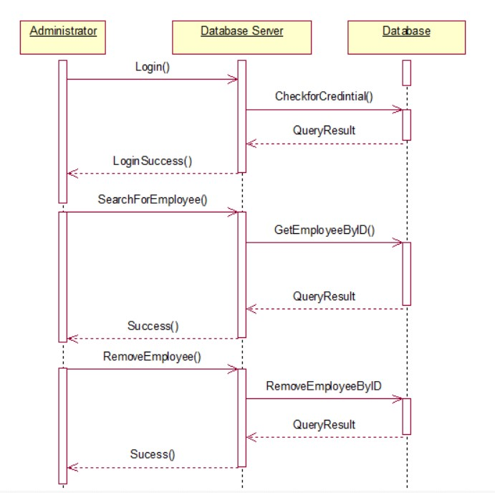
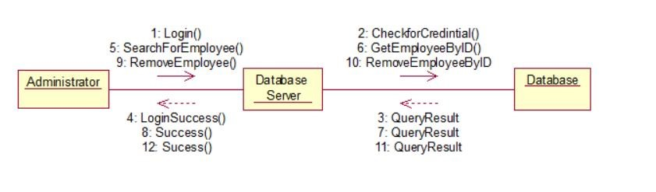
Sequence diagram for manage employee(remove employee)
Collaboration diagram for mange employee(remove employee)

Slide 15
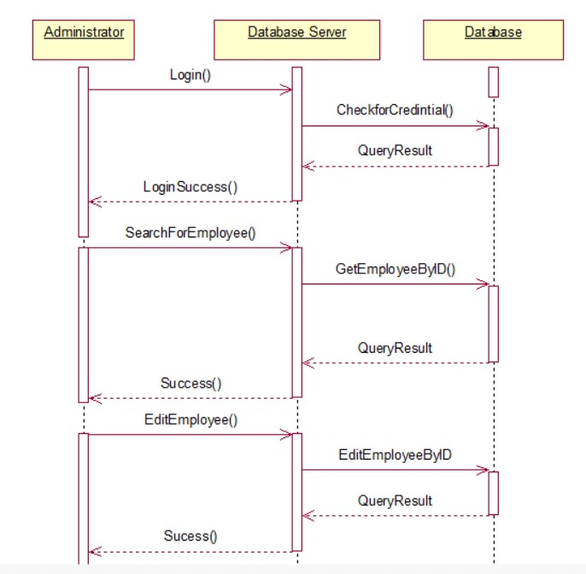
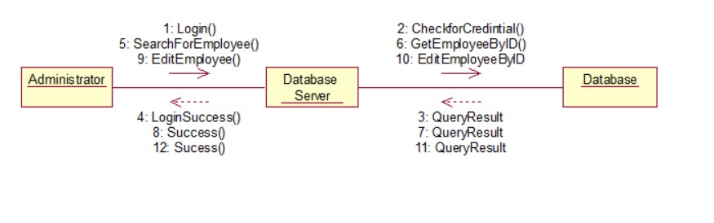
Sequence diagram for mange employee (edit employee data)
Collaboration diagram for mange employee (edit employee data)

Slide 16
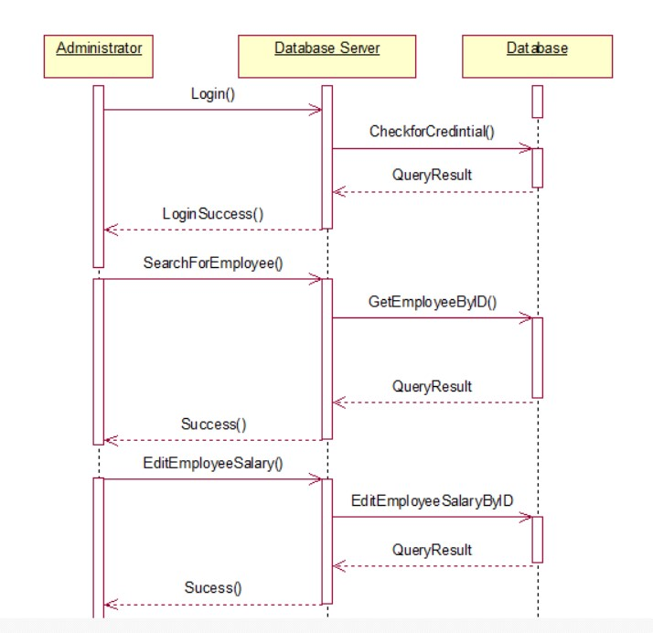
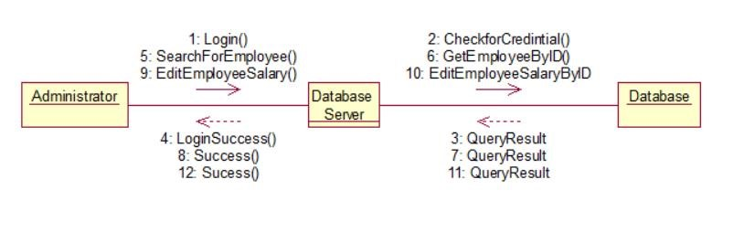
Sequence diagram for manage employee (edit employee salary)
Collaboration diagram for mange employee (edit employee salary)

Slide 17
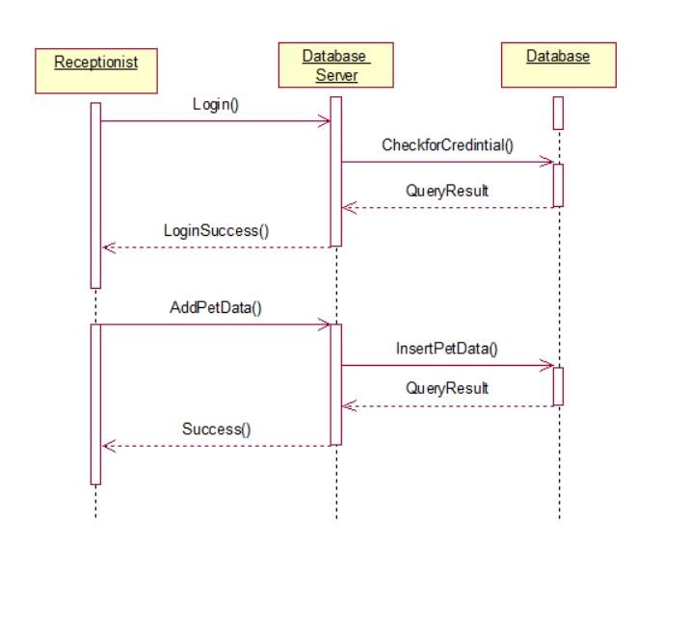
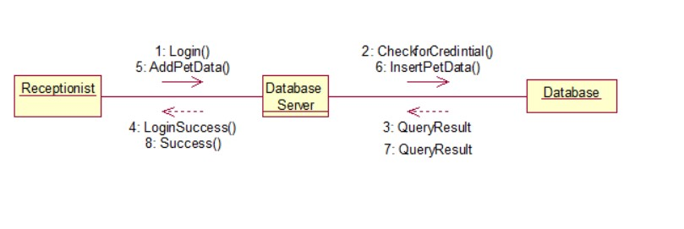
Sequence diagram for add pet data
Collaboration diagram for add pet data

Slide 18
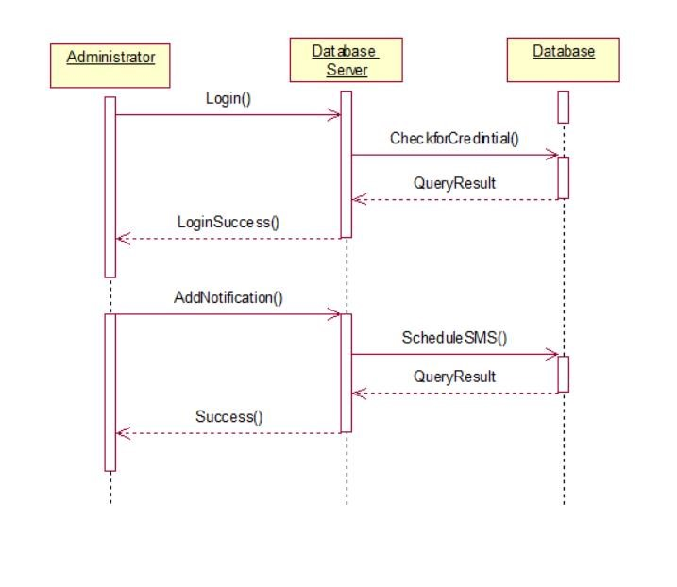
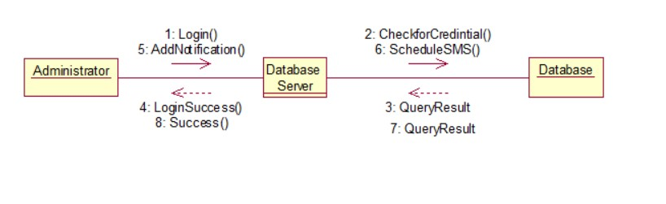
Sequence diagram for notification
Collaboration diagram for notification

Slide 19
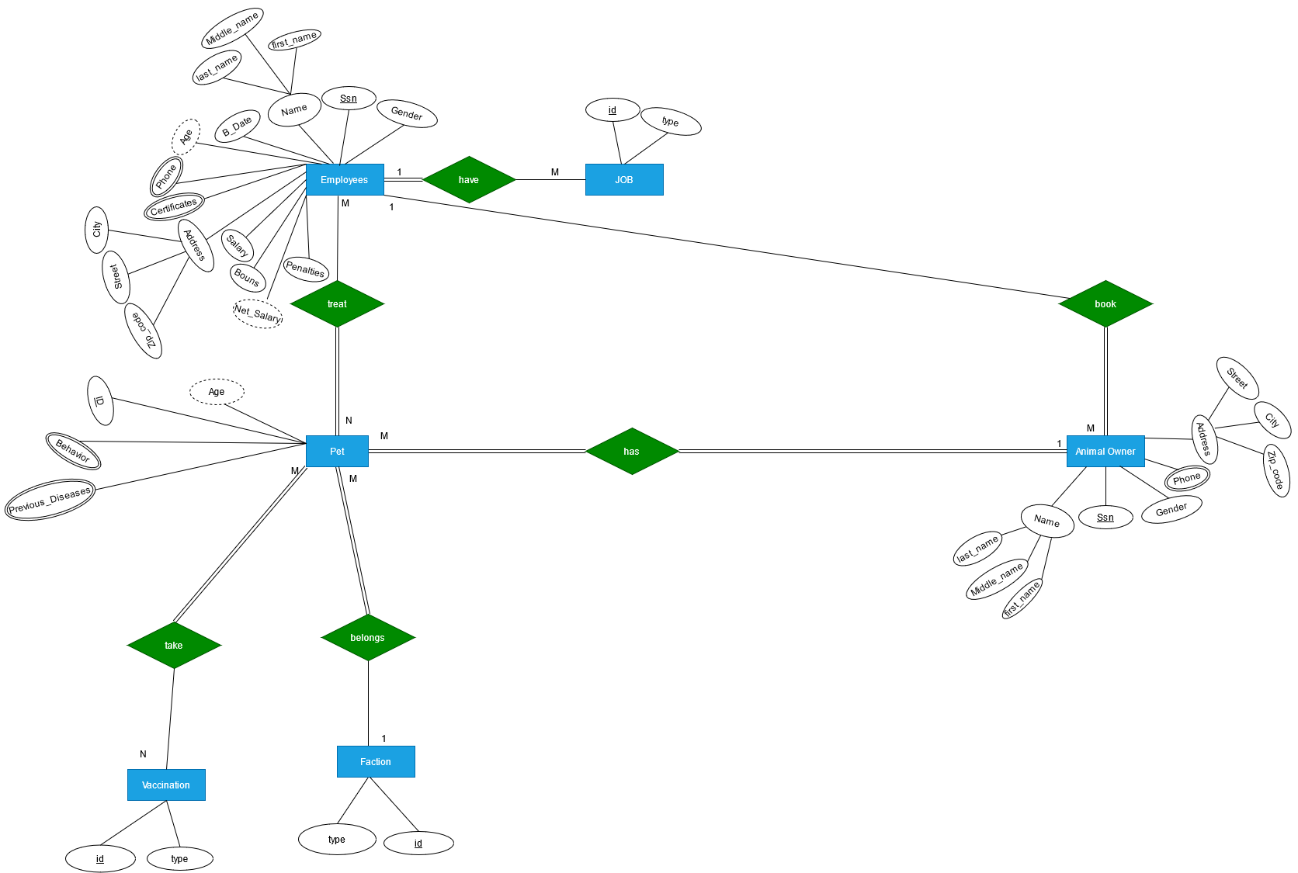
4) ERD:

Slide 20
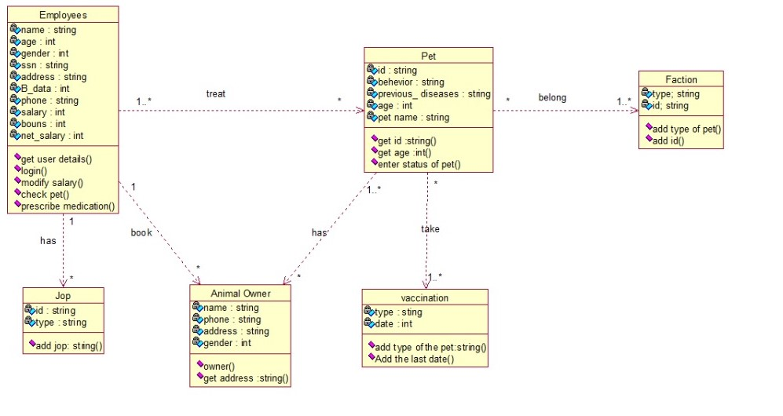
5) Design diagram:
5.1 Class diagram:

Slide 21
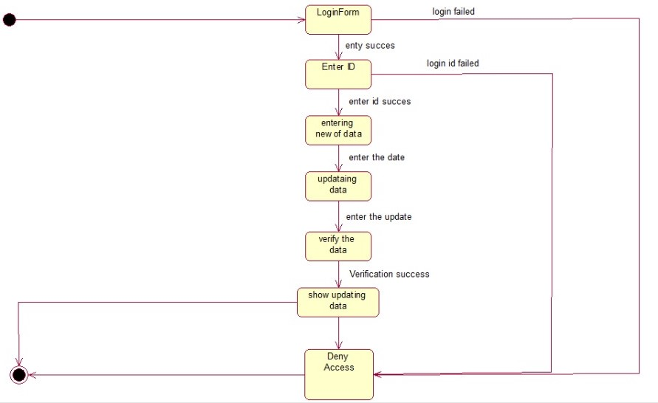
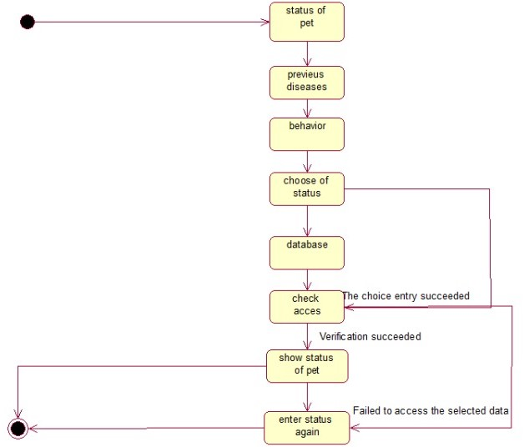
5.2 State chart diagrams:
5.2.2 Status of pet
5.2.1 Update the data

Slide 22
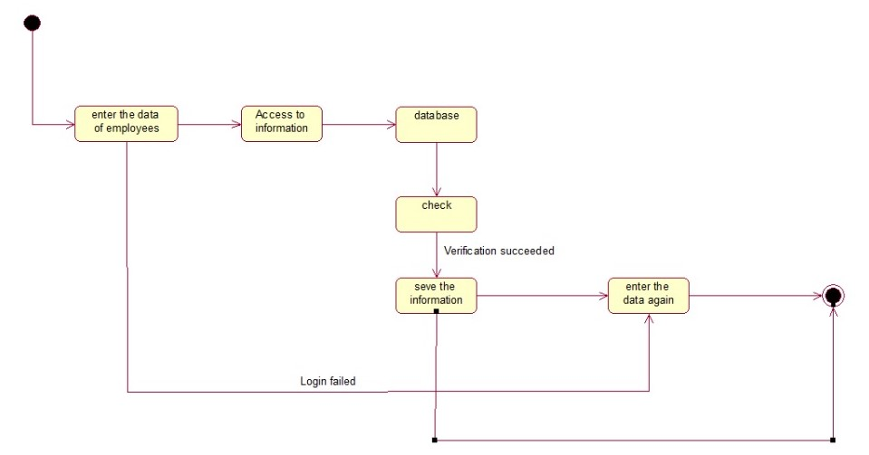
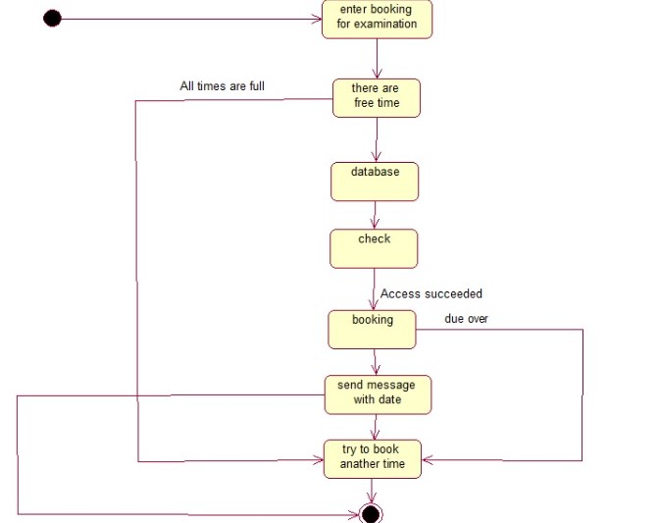
5.2.3 Book by staff
5.2.4 Employee information

Slide 23
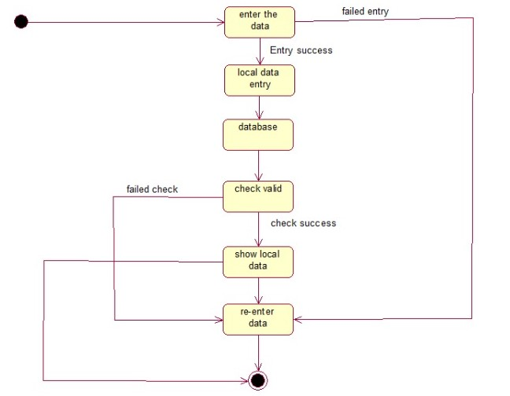
5.2.5 Local data entry
5.2.6 Notification of last vaccination

Slide 24
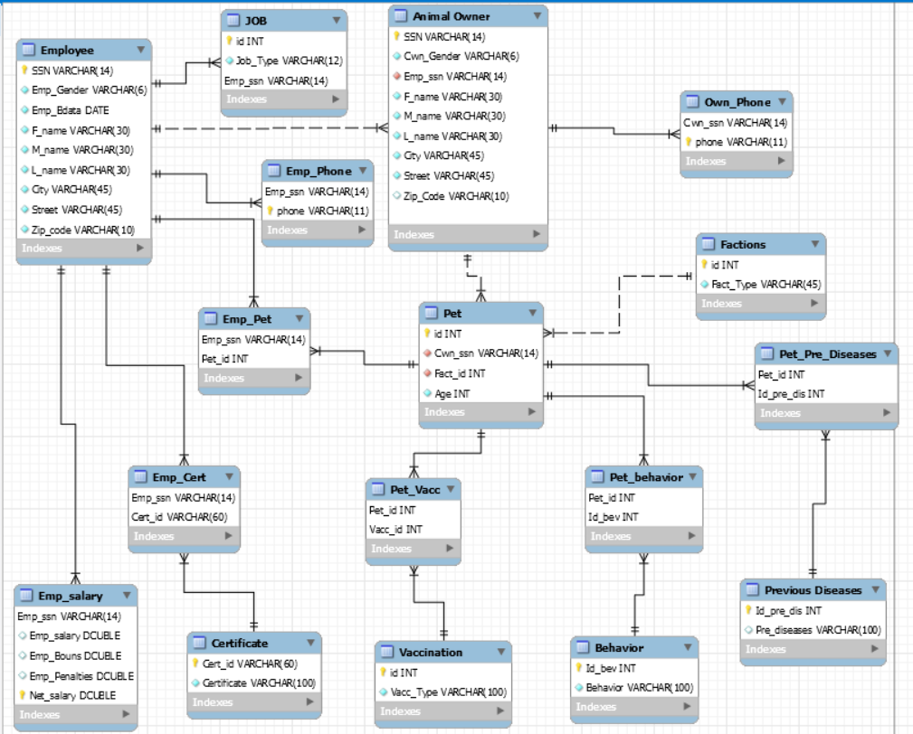
6) Schema:

Slide 25
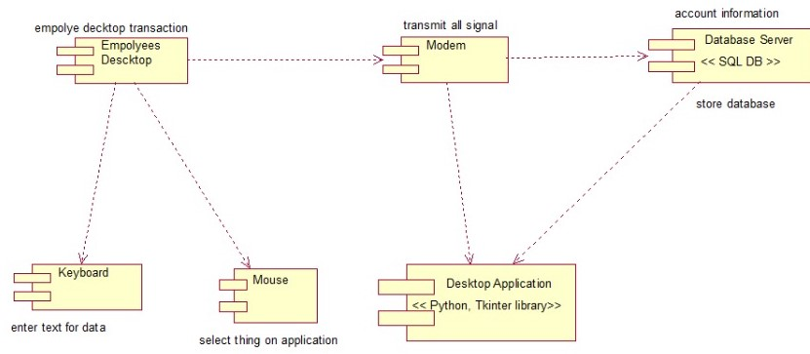
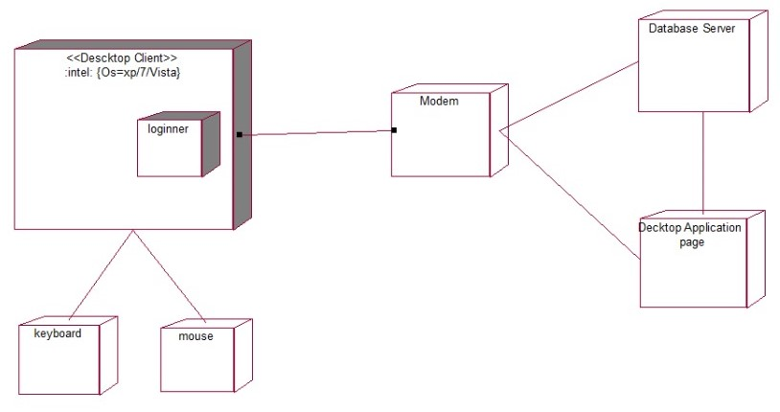
7) Implementation diagrams:
7.1 Component diagram
7.2 Deployment diagram

Slide 26
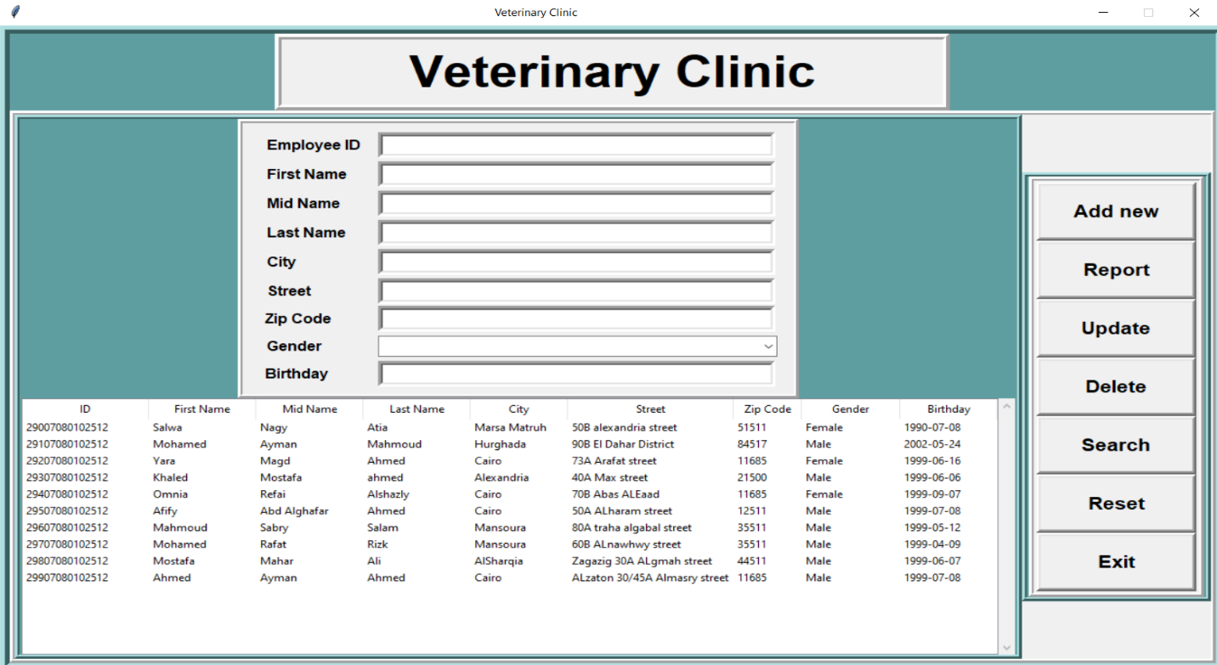
Screenshot of the app:
Report button:
Report button screenshot

Slide 27
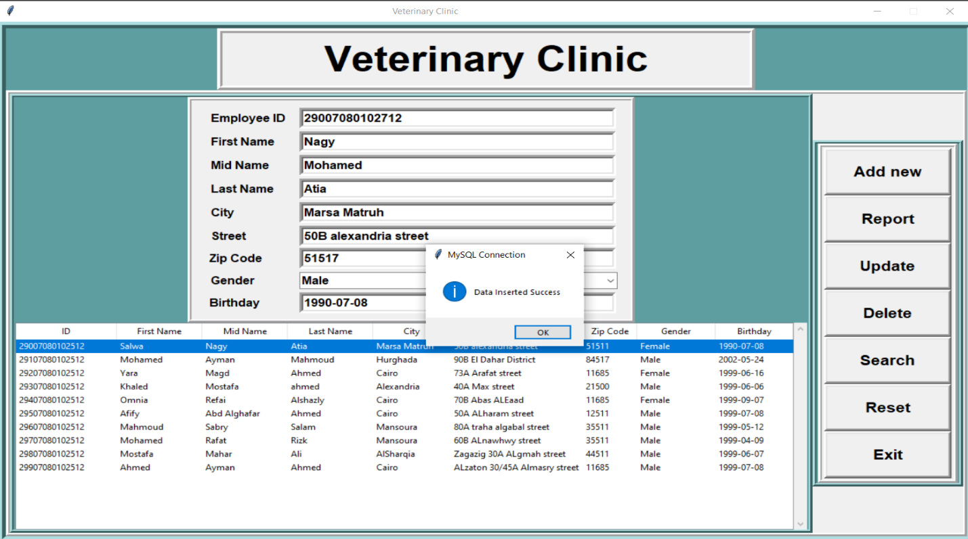
Add new data button:
Adding new data screenshot

Slide 28
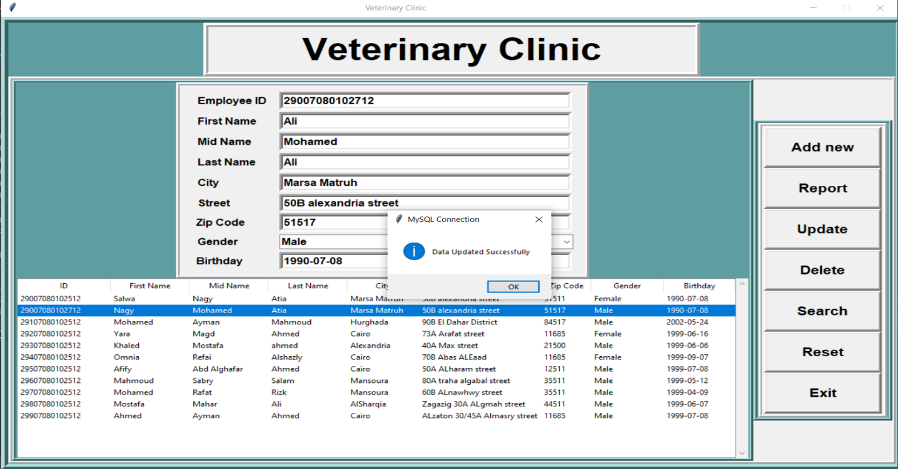
Update data button:
Updating old data screenshot

Slide 29
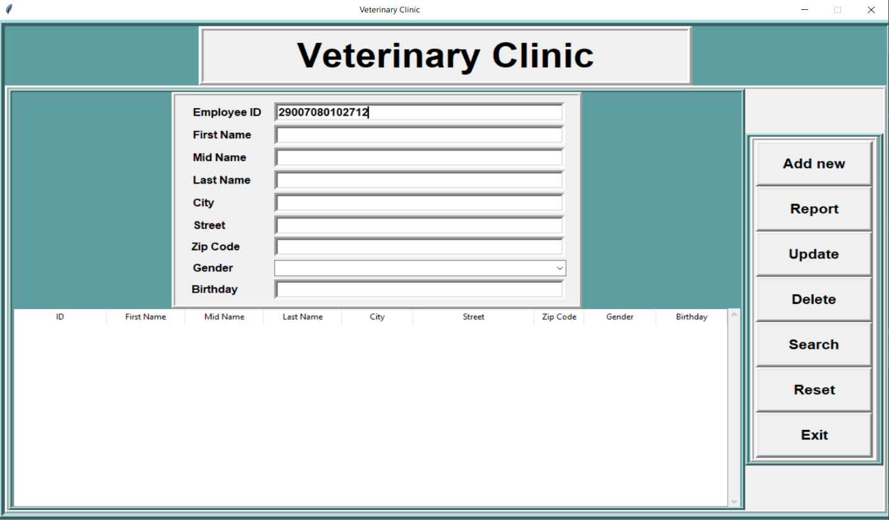
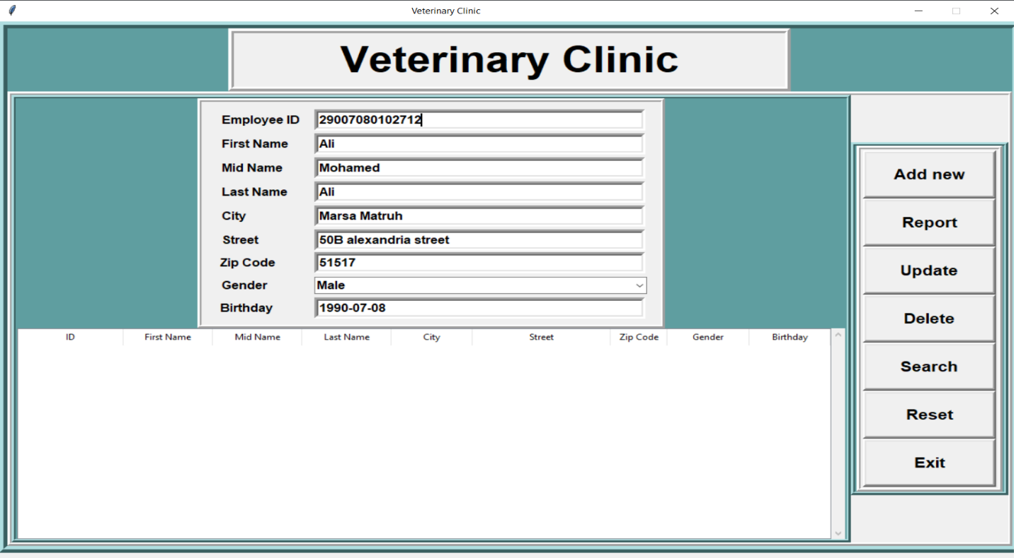
Search button:
Search about existed data by SSN screenshot
The result of search about the data screenshot

Slide 30
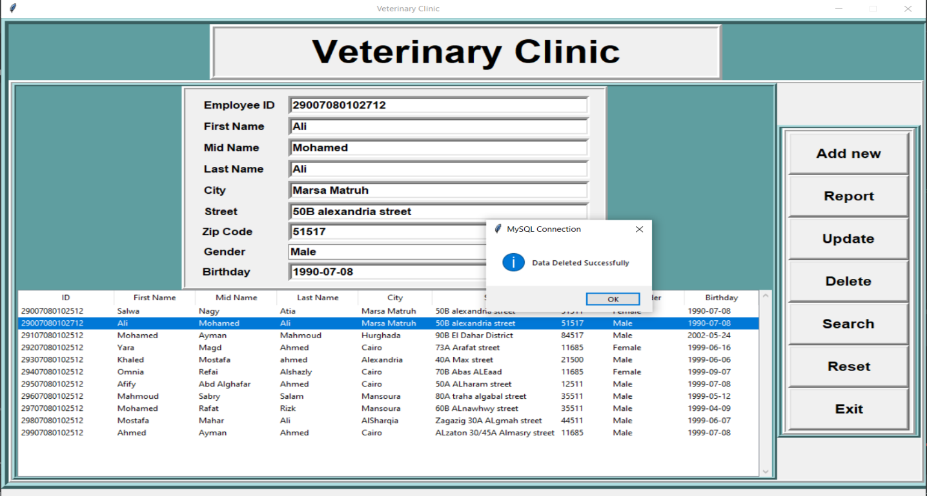
Delete data button:
Deleting data screenshot

Slide 31
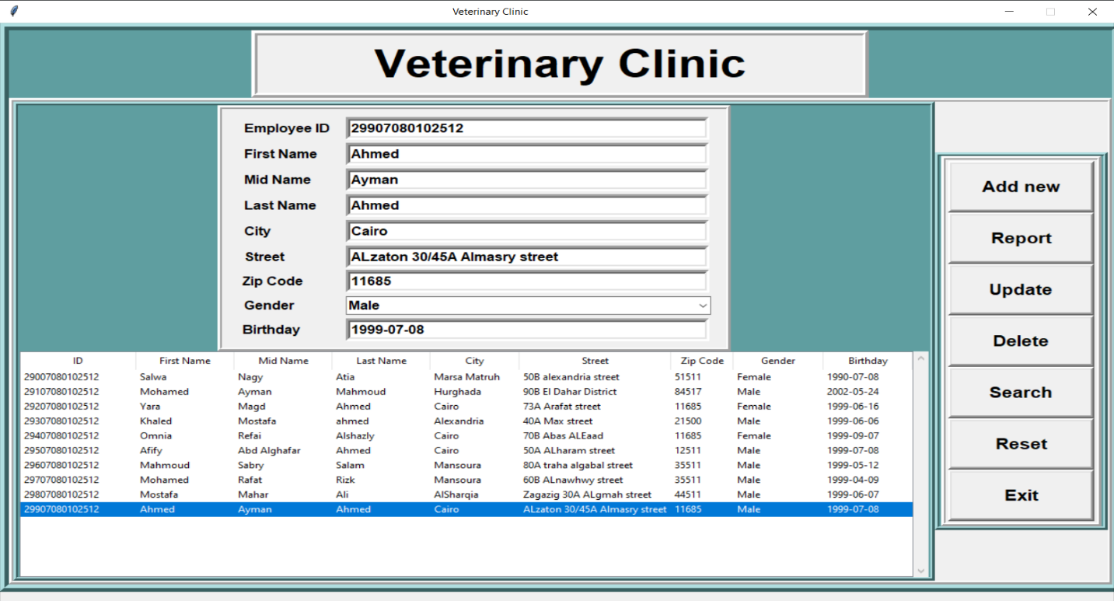
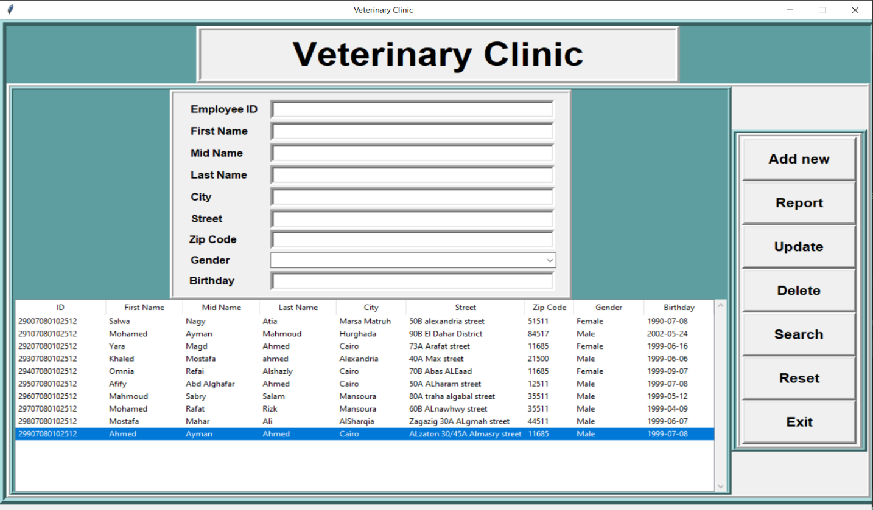
Reset button:
Before resetting the data in the fields screenshot
After the data is reset in the fields screenshot

Slide 32
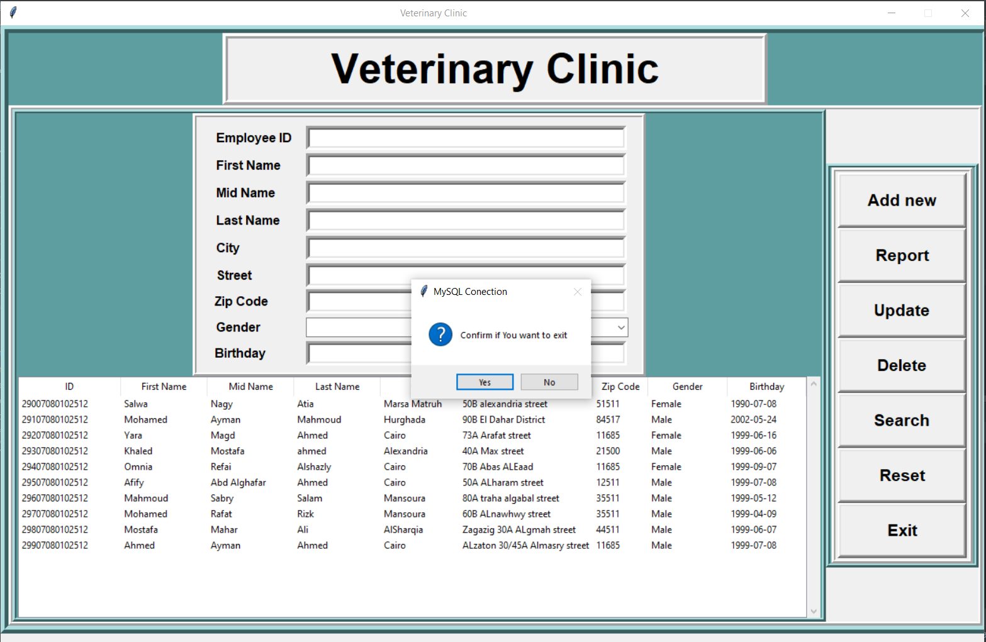
Exit button:
Before exiting from the program screenshot

Slide 33
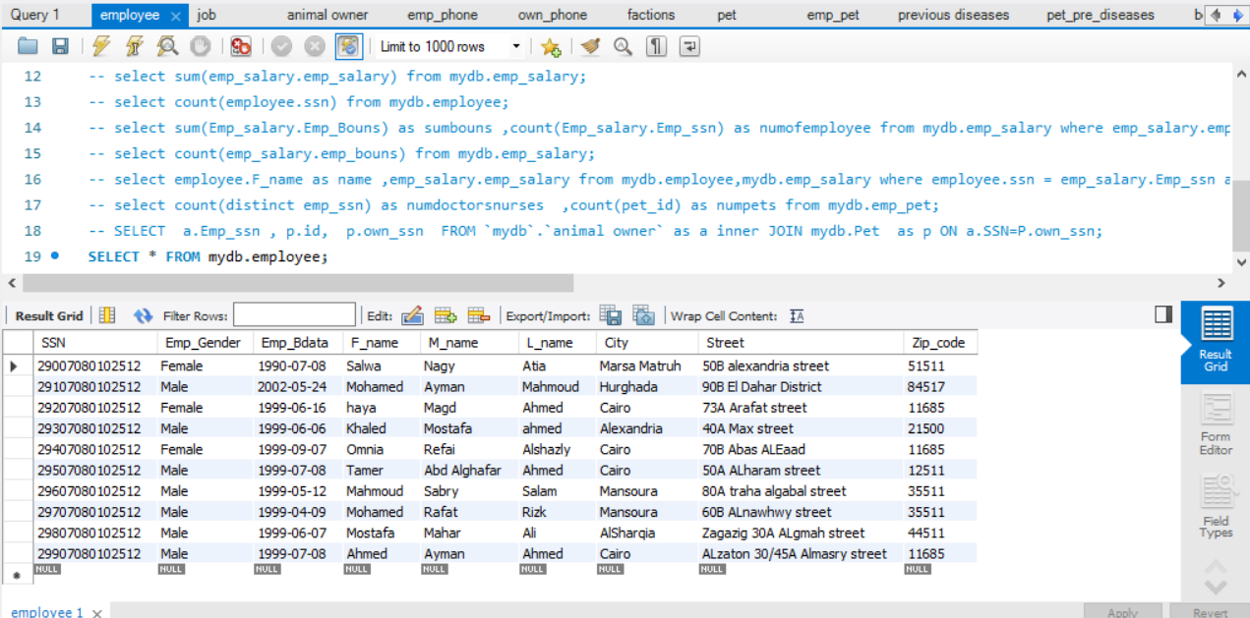
Database screenshot added the data by the app

